Slide 1



North of England LFS Clinical Care and Research
Dr Emma R Woodward FRCP PhD
Consultant Clinical Geneticist, Manchester Centre for Genomic Medicine
Honorary Senior Lecturer, University of Manchester
Co-Director of Research, International Alliance for Cancer Early Detection

Slide 2
Overview
The role of a Consultant Clinical Geneticist
Clinical pathway – surveillance
Service evaluation studies
University of Manchester’s involvement in translational research
Patient research focus group

Slide 3
Consultant Clinical Geneticist, medically qualified Hereditary Cancer Predisposition
Assessing risk, working out likelihood of high-risk hereditary predisposition for pattern / types of cancer in individual /family
Where there is likely high-risk hereditary predisposition → put appropriate cancer prevention and / or early detection strategies into place
Early detection picking up a cancer before individual notices anything amiss not diagnostic investigation of new symptoms / signs

Slide 4
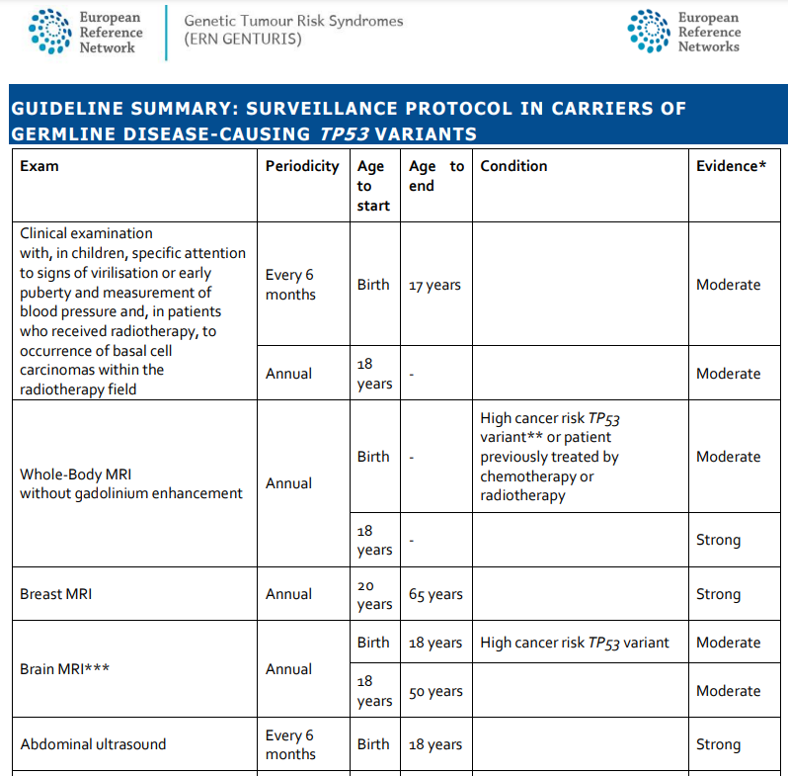
Whole Body MRI (WBMRI)
Diffusion weighted imaging (cellular/tissue components have different water diffusion properties)
Helps detect small lesions
https://www.genturis.eu/l=eng/Assets/TP53-Surveillance-Guideline---ERN-GENTURIS-Version7011.pdf

Slide 5
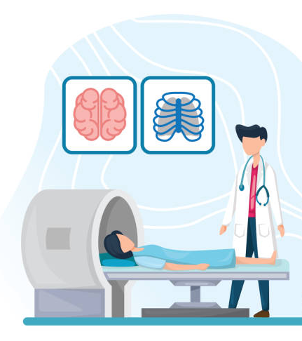
Surveillance
Annual clinical examination & imaging
Patient required to travel to hospital with WBMRI machine
Aim to detect concerning lesions before individual presents with symptoms / signs
Surveillance scans, not diagnostic investigations
If develop symptoms / signs in that intervening year, then must seek advice from usual medical services eg through GP
https://www.istockphoto.com/
False positive
Imaging / examination detects something, individual has further investigations, turns out not of concern Can cause anxiety
False negative
Imaging / examination misses a concerning lesion Delayed cancer diagnosis

Slide 6
Roles in Clinical Early Detection - who does what
LFS Clinician
Request surveillance imaging and see individuals in surveillance clinic
Radiology Department
Triage radiology requests made by clinician and book scans as appropriate
Radiographer
Healthcare professionals who take scans of patients
Radiologist
Interprets the scan images, writes a report, and sends report to requesting clinician

Slide 7
Surveillance scan is reported
Normal Clinician writes letter advising the result is normal and requests for appointment in next clinic
Abnormal Clinician writes letter advising the individual of the results eg diagnostic investigation recommended and offer to speak to / see person
Generally see individuals annually
If queries around eg PGD, predictive testing for children – separate dedicated genetic counsellor appointment

Slide 8




Discovery Research & Clinical Care
Research guided by patient input
New Standard
Clinical
Care
Discovery
Research
Validation

Slide 9
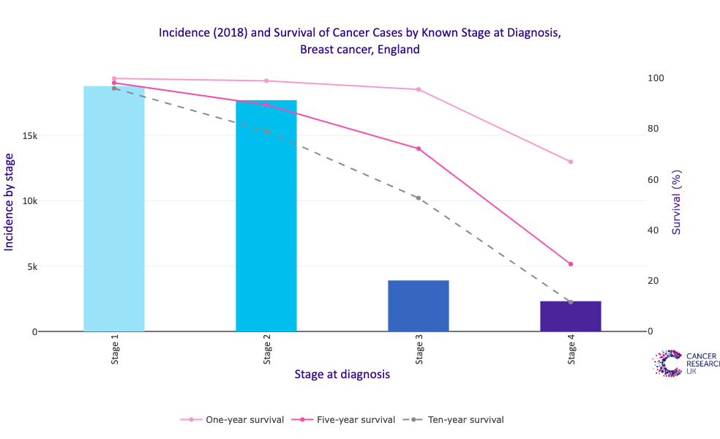
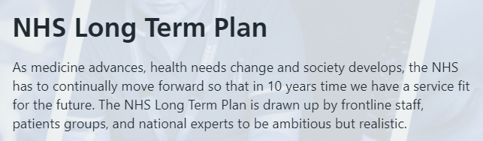


Why early detection and interception?
Survival and Stage at Diagnosis are Closely Linked
¾ cancer diagnoses to survive 10years by 2034
¾ of cancer diagnoses to be Stage 1-2 by 2028
https://ourfuturehealth.org.uk/cancer-research-uk-and-our-future-health/
https://www.england.nhs.uk/long-term-plan/

Slide 10


Li Fraumeni Syndrome Discovery Research in Manchester
New ways of detecting cancer early
Early changes in tissue: normal → cancer Need to know this, to then think about interception
Interception
Collaboration with Ontario Institute for Cancer Research (OICR)
Participation is entirely optional, we offer but is totally up to individual / parents
Not being involved does not prejudice clinical care

Slide 11
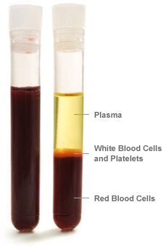
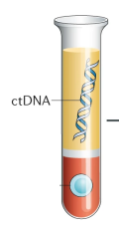
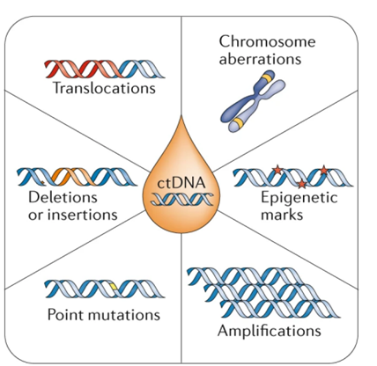


University of Manchester researchers are aiming to co-develop a cancer early detection blood test
Collaboration:
Data sharing is key

Slide 12


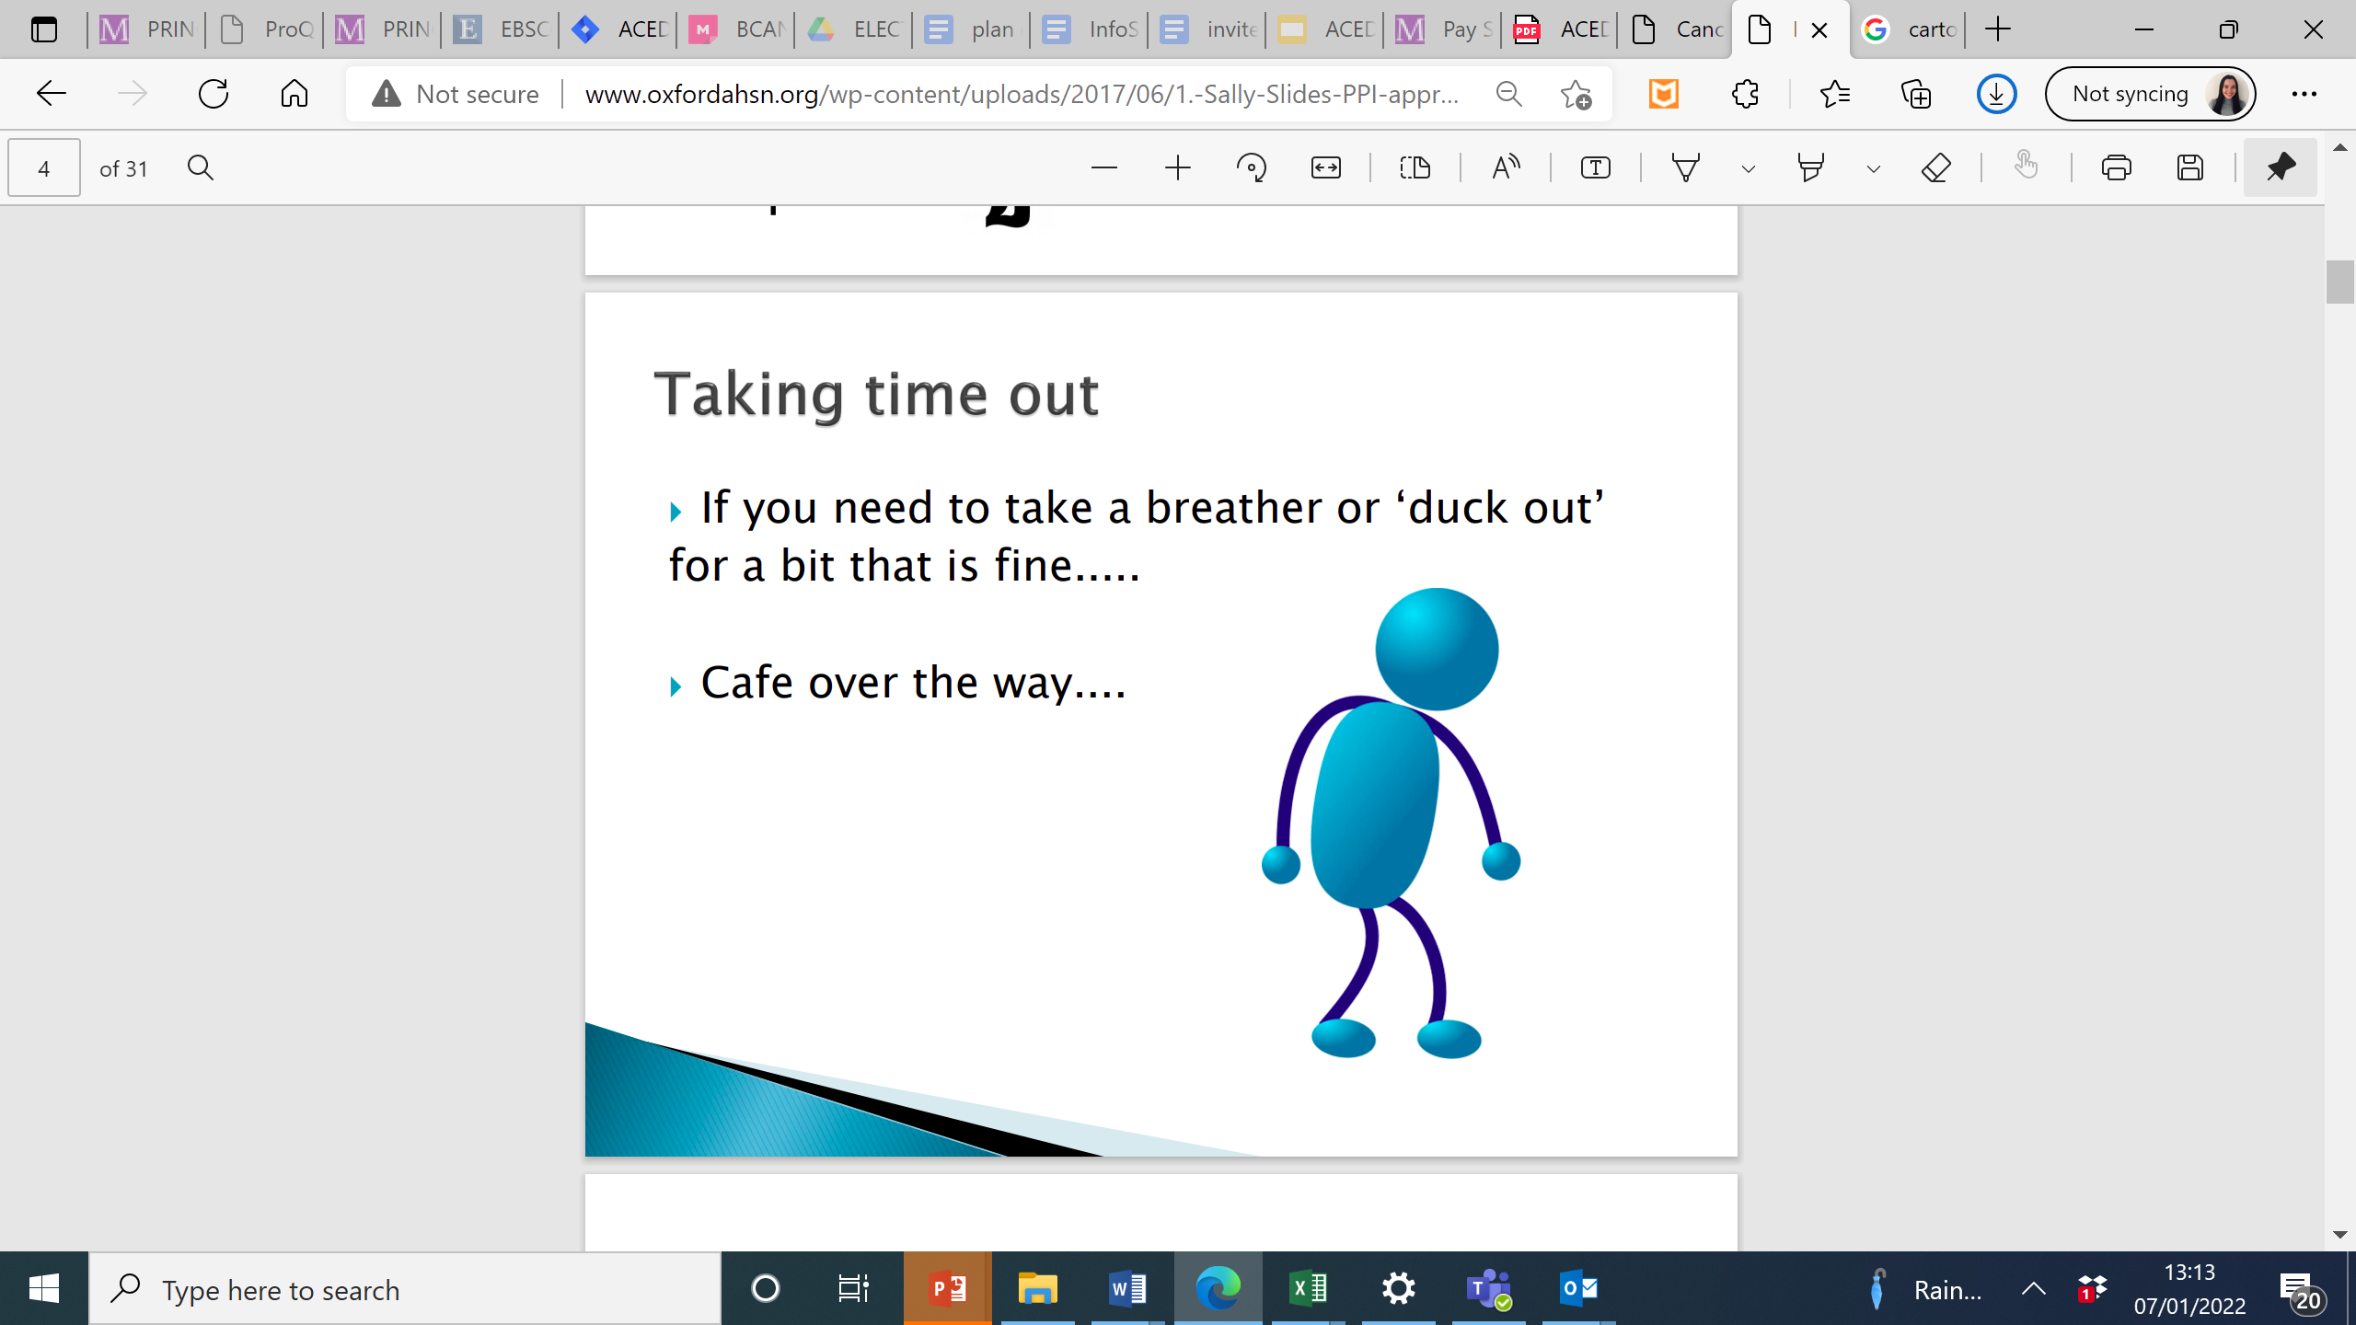
Inputs from our active Patient Research Focus Group shapes the research study design
Ongoing open dialogue
We share our contact details - participants can get in touch if they have ideas for future research
We welcome feedback and adapt the delivery of the forum to suit the attendees
Safe Space
Confidential
Thoughts and questions
Stepping away
Comfort Breaks
Reimburse attendees for their time
Slide created by Stephanie Ng, University of Manchester

