Slide 1
LFS UK 2023 Updates on SIGNIFIED and ICED studies – the Royal Marsden Hospital
Dr Elena Cojocaru, clinical research fellow
Dr Angela George, consultant medical oncologist
09/09/2023

Slide 2
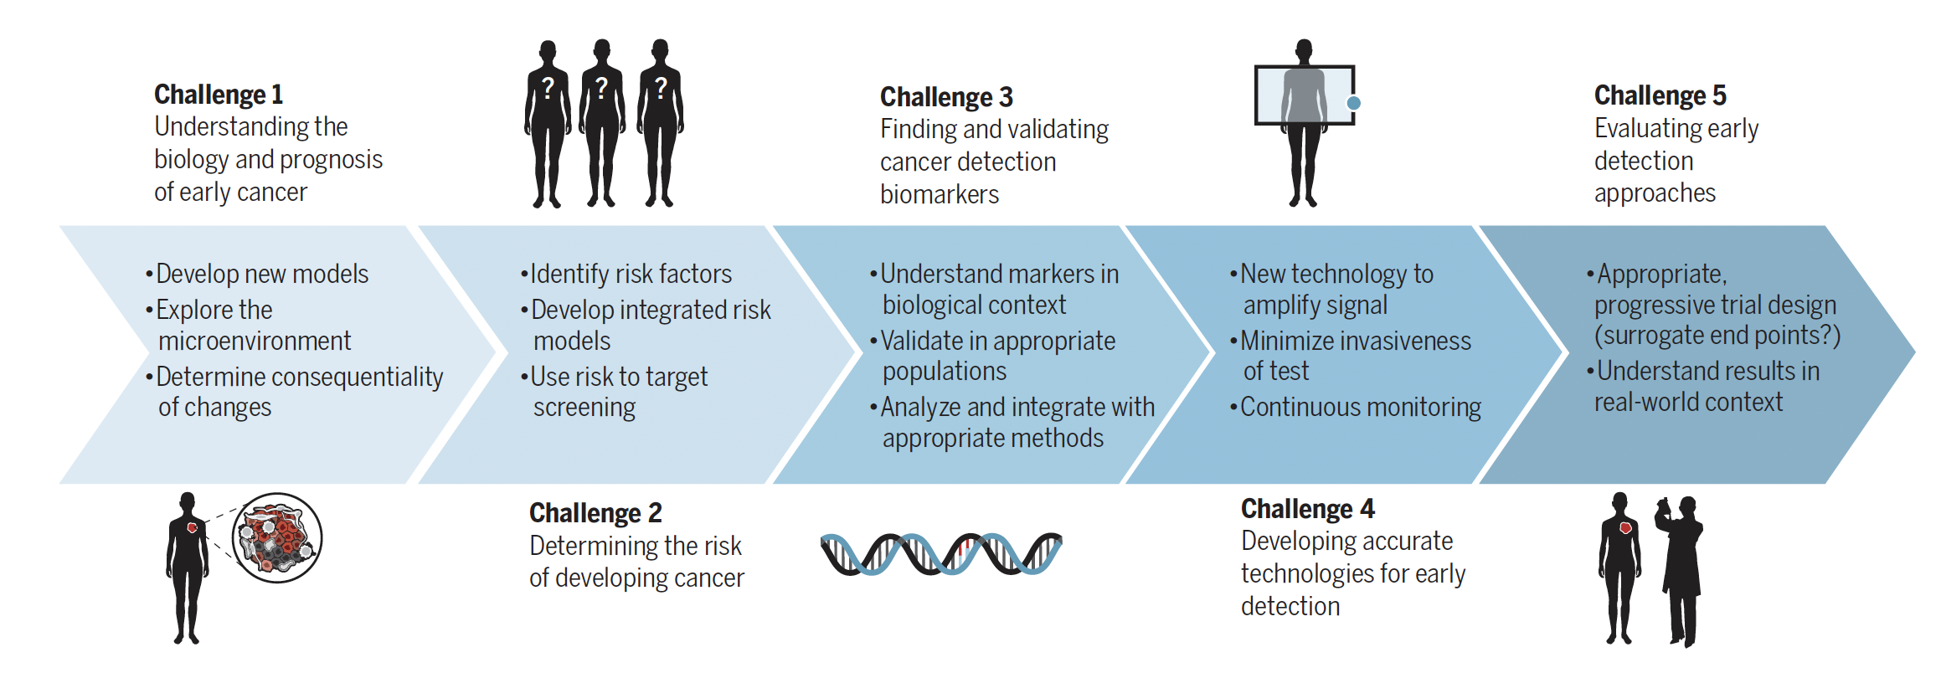
Challenges of early detection
Crosby et al., Science 375, 1244 (2022)

Slide 3
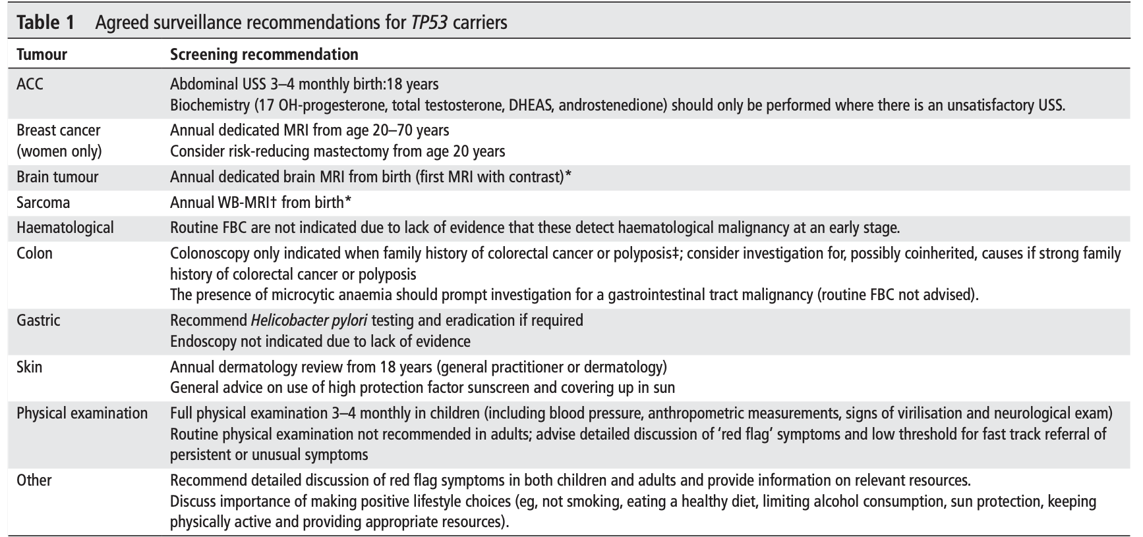
Li Fraumeni syndrome – screening recommendations
NHS screening - breast screening for women
WB-MRI is not widely available across the UK
Hanson H, et al. J Med Genet 2021;58:135–139.

Slide 4
Li Fraumeni syndrome - SIGNIFY study (2017)
44 TP53 mutation carriers and 44 population controls underwent a one-off Whole-body MRI.
In TP53 mutation carriers, 6 of 44 (13.6, 95% CI 5.2–27.4%) participants were diagnosed with cancer during the study
Two outside of MRI – 4/ 44 true positives (9%)
False negative: 1 lesion thought to be benign on MRI that proved to be cancerous and 1 blood cancer
False positive – two invasive procedures
bone biopsy
removal of ovaries for benign lesions

Slide 5
Study (PMID) | Number of subjects scanned |  | No findings | Benign findings, no follow-up | Possibly malignant findings – required further investigations | Malignancy confirmed | Other
 | Paediatric | Adults
LEAD* PMID 28988289 | 0 | 53 | 0 lesions in 19 patients | 22 lesions in 14 patients | 29 lesions | 6 patients
SIGNIFY study – one scan per patient PMID 28091804 | 0 | 44 | 26 |  | 15 patients | 6 patients (2 outside the MRI) | False positive 9 pts Non-malignant 3 pts True negative 26 pts False negative 2 pts
SWEP53 PMID 35053544 | 11 | 68 | 42 |  | 19 patients - Benign 21 lesions in 16 pt (84%) - Malignant 9 lesions in 3 pts (16%) | 3 patients
Paixao (Brazilian cohort) – 2 scans per patient PMID 30107858 | 0 | 59 |  |  | > Positivity rate 11.8 % after first MRI (7) 6.7% (4) after second MRI Total 9.3% (11) | 11 patients Cancer detection rate - 3.4% (2) after 1st MRI - 1.7% (1) after 2nd MRI - total 2.5% (3) | Success rate 95.0 % (56) after first MRI 100.0% (59) after second MRI 98.0 % (116) total
Dana Farber – 2 or 3 scans per patient PMID 29077256 | 20 | 0 | 15% of patients |  | 30% of patients (intermediate + moderate/significant concern) | 0 patients
Annupindi PMID 26204294 | 24 | 0 |  | 55 incidental findings | 7 patients: Five low-risk lesions | 1 patient | Se 100% Sp 94% PPV 24% NPV 100%
Ballinger metanalysis PMID 28772291 | 444 | 134 | 405 patients |  | 173 patients 202 Lesions imaged 51 Biopsies 13 Lesions with uncertain diagnosis | 39 patients

Slide 6
SIGNIFIED study - Aims
Primary aim: To assess the incidence of malignancies diagnosed in asymptomatic TP53 carriers using two whole body MRI scans, at 12 months apart
Secondary aims: To determine the cost-effectiveness of screening with WB-MRI and treating early cancers compared to management of symptomatic cancers, using historical controls and a decision analytic model

Slide 7
SIGNIFIED study - Endpoints
Primary endpoint
• Diagnosis of new cancers via screening with WB-MRI
Secondary endpoints
• Sensitivity and specificity for detection of malignancies at repeat imaging (following a second WB-MRI)
• Number of new non-malignant (benign) diseases diagnosed, and further investigations required
• Cost of WB-MRI and early diagnosis management compared to cost implications of diagnosis of advanced cancer
• Quality of life assessments in Li Fraumeni patients undergoing WB MRI
• Cost effectiveness analysis to estimate the value of implementing WB-MRI as the standard of care for LFS
• Estimation of the incremental cost per quality-adjusted life year (QALY) and return on investment analysis (ROI) comparing the net benefits relative to the additional cost

Slide 8
SIGNIFIED study - inclusion/exclusion criteria
Inclusion criteria 1. Patients over the age of 18 years old, with no active cancer 2. Carriers of a pathogenic/likely pathogenic variant the TP53 gene 3. Able to give informed consent Exclusion criteria Carriers of a variant associated with reduced penetrance (in the view of a geneticist) or a variant of uncertain significance. Patients with a malignancy diagnosed in the previous 5 years [except non-invasive tumours]

Slide 9
SIGNIFIED study - Study design

Slide 10
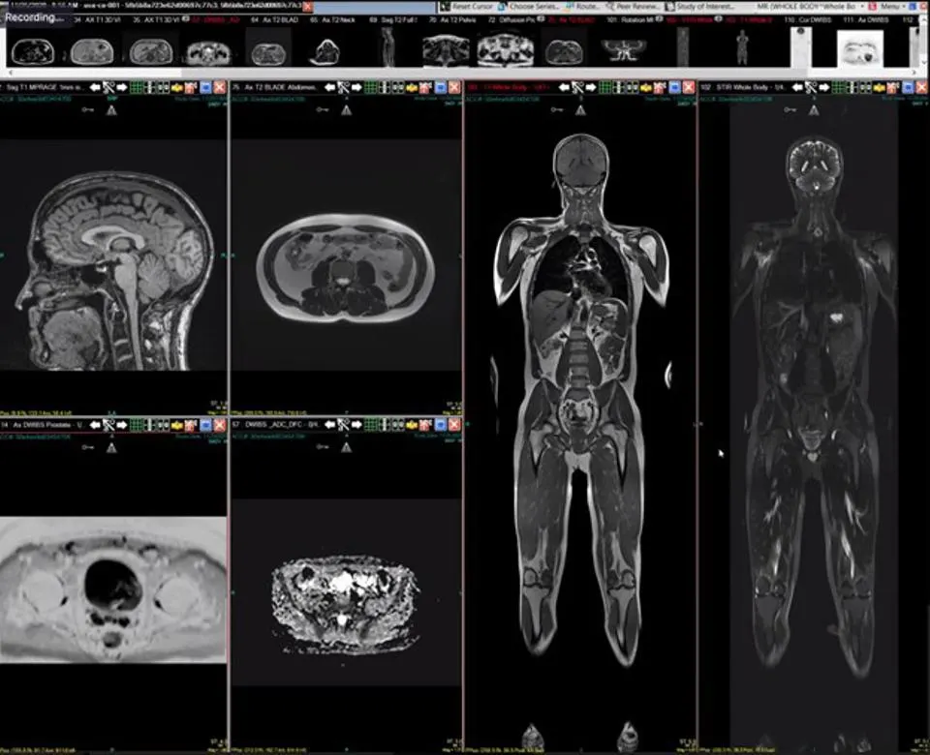
Whole-body MRI
Head to toe examination
Non-contrast
Diffusion weighted and conventional MRI images
Slice thickness 8mm
1.5 Tesla MRI machine

Slide 11
SIGNIFIED study - Recruitment
55 participants recruited between June 2022 - June 2023
53 had their WB-MRI at the RMH
2 participants consented for their scan done externally to be used for the data analysis
2 patients were referred but declined the study
RECRUITMENT SOURCES:
RMH patients
Contact with London genetic centers
The George Pantziarka TP53 trust
Dissemination at the Winter Cancer Genetic Group (CGG) meeting 2021/2022

Slide 12
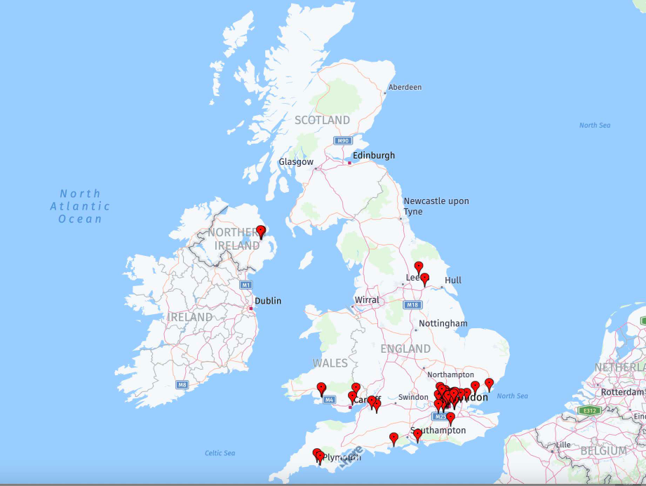
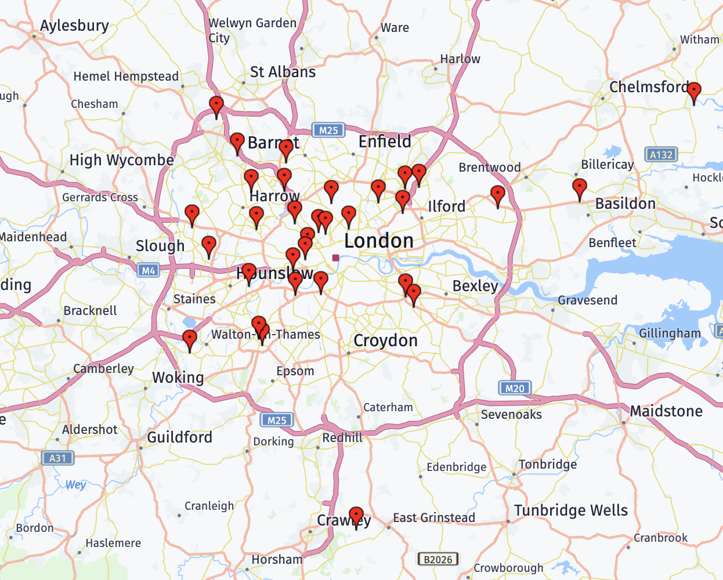
SIGNIFIED - UK and London distribution

Slide 13
SIGNIFIED study - Results
Males: 14/ Females: 41
Median age at recruitment : 41 years old
Previous history of cancer
Females
Yes: 19 (breast cancer most common)
No: 22
Males
Yes: 4
No : 10

Slide 14
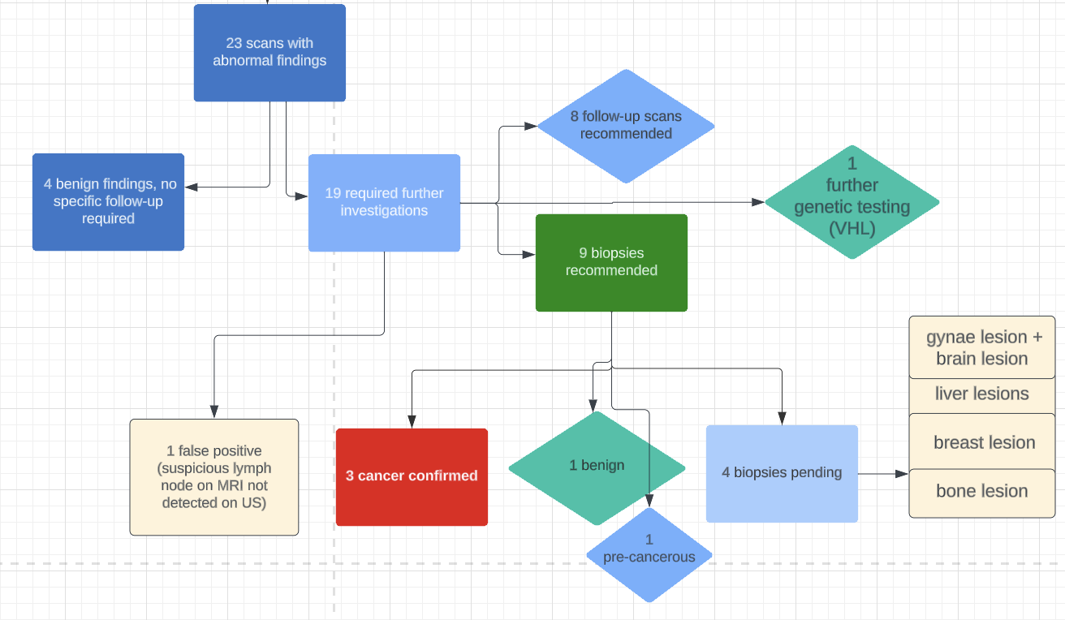
Results - 1st round of scans

Slide 15
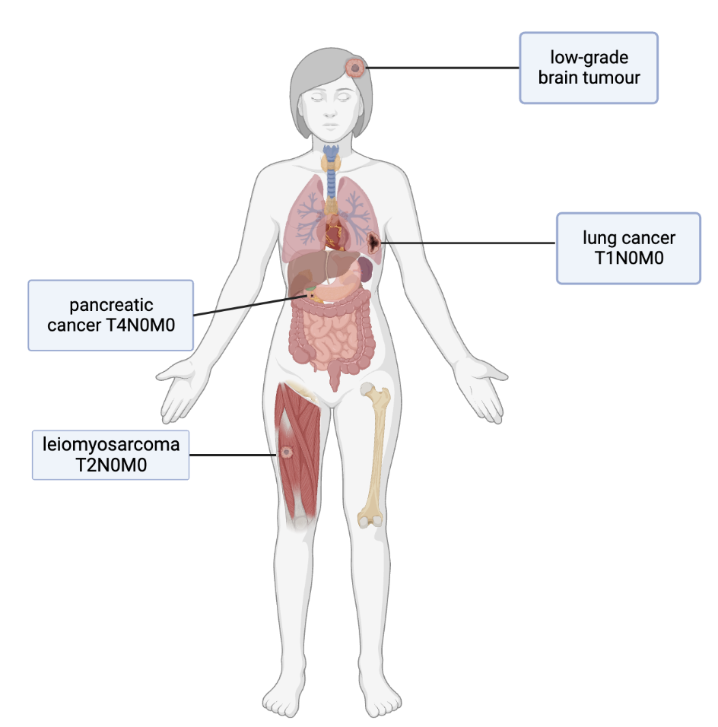
Confirmed cancers or highly suspicious

Slide 16
SIGNIFIED study - Challenges
Organizing local investigations and chasing external results
Limited knowledge of Li Fraumeni of medical professionals with no genetic experience – difficulty in convincing external physicians/ GP of the necessity of biopsies/surgeries/urgent referrals
Lack of appropriate MDT for non-oncological patients at the RMH (i.e. TYA, Neuro-oncology)

Slide 17




Clinical research and operational team SIGNIFIED
Dr Angela George (CI)
Prof Ros Eeles
Dr Richard Lee
Dr Aslam Sohaib, radiologist
Dr Sam Whitey, radiologist
Prof Dow-Mu Koh, radiologist
Dr Caroline Clarke, HE (UCL)
Dr Jessica Wang, HE (UCL)
Sofia Sardo, statistician
Lydia Taylor, research nurse
Dr Michelle Chen, RMP
Mr. Shafa Ullah, ED&D

Slide 18
ICED study (liquid biopsy study)
Aims
- set up a biobank of very rare blood samples
- assess if we can detect traces of tumour DNA in the blood
- assess the proportion of patients who develop cancer during study and compare those with ctDNA detected and those without ctDNA detected.
- our ultimate aim is to develop a blood/urine test that can detect cancer early

Slide 19
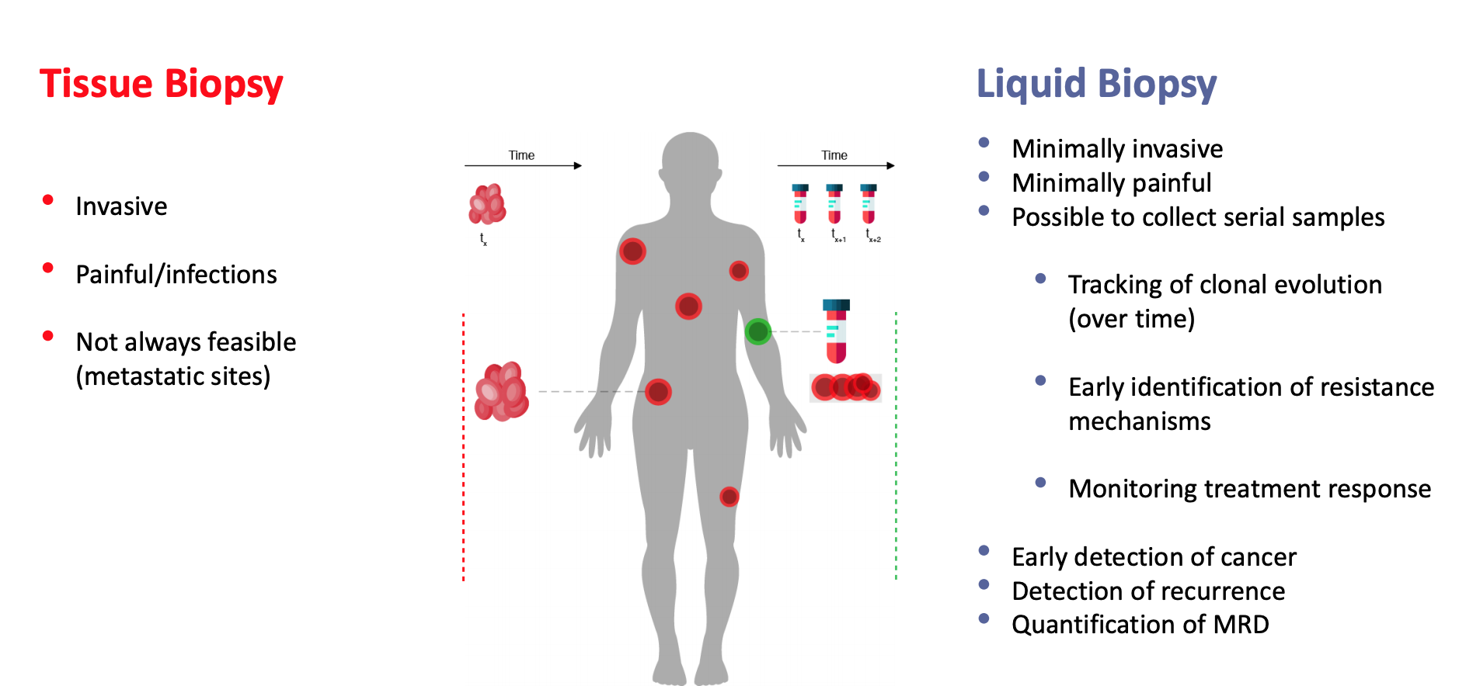

Slide 20
Genetic syndromes
Li Fraumeni (TP53)
Currently only screening in NHS is breast MRI
SIGNIFIED service evaluation (WB-MRI)
Lynch (MMR genes)
CRC, endometrial, brain, GU cancers
GI screening – colonoscopy
CAPP2/CAPP3 trial – aspirin

Slide 21
Genetic syndromes
PTEN (Cowden syndrome)
Breast cancer, Thyroid, GU (endometrial, renal), colorectal, brain
Peutz-Jeghers syndrome (STK11)
50% risk of cancer by age 50: breasts, pancreas, gastrointestinal tract and ovaries.
Screening: OGD, colonoscopy, gynae screening, breast
MUTYH-associated Polyposis syndrome (MAP) - MUTYH biallelic
Juvenile Polyposis Syndrome (SMAD4)
Familial Adenomatous Polyposis syndrome (APC) - pre/post surgery
Hereditary diffuse gastric cancer (CHD1) - pre/post surgery

Slide 22
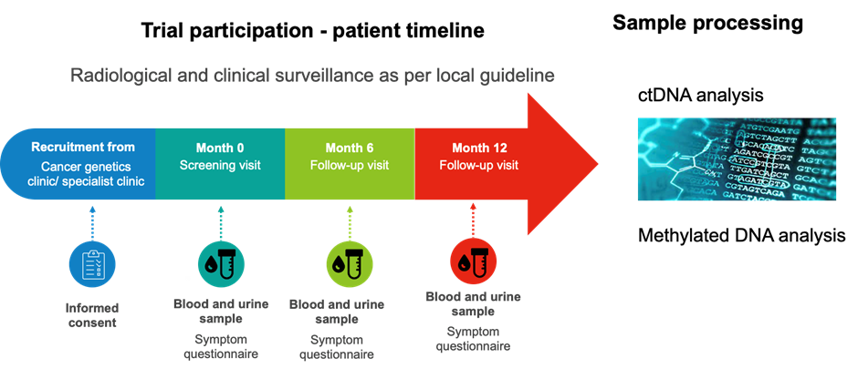

Slide 23
ICED study - Inclusion/exclusion criteria
Cohort 1: TP53 germline mutation carriers
Cohort 2: Lynch syndrome, PTEN, Peutz-Jeghers
Age >18 yo, capacity to consent
No history of malignancy other than non-melanomatous skin cancer or cervical carcinoma in situ (CIS) in the past 5 years – to avoid contamination with recurrence from a previous tumour

Slide 24
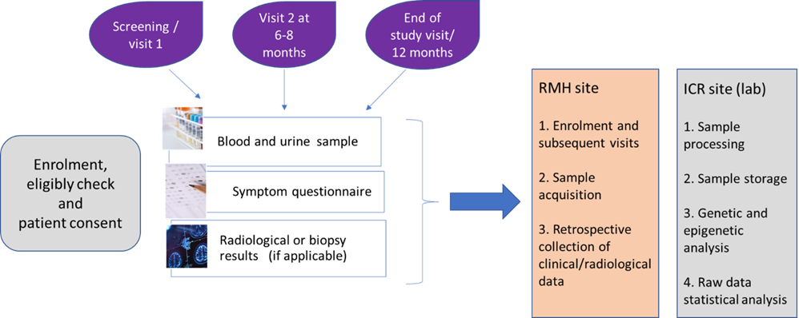
Laboratory analysis
ICED study - design
Results

Slide 25
Clinical research and operational team ICED
Dr Angela George (CI)
Dr Richard Lee
Prof Ros Eeles
Lydia Taylor, research nurse
Sejal Jain, trial manager
Laura Boddy, data manager
Sofia Sardo, statistician
Catey Bounce, statistician
LAB TEAM
Prof Mike Hubank
Dr Andrew Feber
Paula Proszec, postdoc
Michaela Smilley, lab technician

