Slide 1

Update on NHS LFS Screening Protocol
Dr Helen Hanson
St Georges NHS Foundation Trust

Slide 2
Background : Screening recommendations in LFS
UK- only National screening recommendations are for breast MRI from age 20 (NHSBSP)
Increasing literature demonstrating early cancer detection through more comprehensive screening
  SIGNIFY (UK)
  Toronto protocol Villani et al. Lancet Oncol 2011 and 2016
  Meta-analysis of baseline surveillance with WB-MRI in Li-Fraumeni syndrome. Ballinger et al. JAMA Oncology 2017

Slide 3
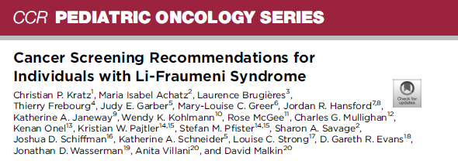
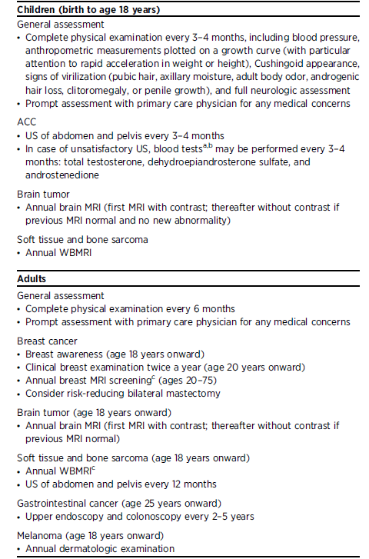
Notes:
Same protocol regardless of mutation

Slide 4


UK Consensus Meeting –6th July 2018
Aspiration for consistent UK approach –meeting convened 6th July by UK CGG
43 attendees –Clinical Genetics, Paeds Oncology, Radiology, Patients
3 discussion groups –mixed specialties – 3 sessions
What?
What screening should we recommend
Where?
Local v national?
Who?
Adults /Children
Confirmed carriers only?

Slide 5
UK Consensus Group Recommendations
Tumour | Screening recommendation
ACC | Abdominal USS 3-4 monthly birth-18 years Biochemistry (17 OH-progesterone, total testosterone, DHEAS, androstenedione) should only be performed where there is an unsatisfactory USS
Breast Cancer | Annual dedicated MRI from age 20-70 (As per NHSBSP 74) Consider risk reducing mastectomy from age 20
Brain tumour | Annual dedicated brain MRI from birth (first MRI with contrast)*
Sarcoma | Annual WB-MRI from birth*
Haematological | Not indicated due to lack of evidence
Colon | Colonoscopy only indicated when family history of colorectal cancer or polyposis. Consider other, possibly co-inherited, causes as appropriate.
Gastric | Recommend Helicobacter pylori testing and eradication if required Endoscopy not indicated due to lack of evidence
Skin | Annual dermatology review from 18yrs (GP or Dermatology)
Physical examination | Full physical examination 3-4 monthly in children (including blood pressure, anthropometric measurements, signs of virilisation and neurological exam) Routine physical examination not recommended in adults – advise detailed discussion of “red flag” symptoms and low threshold for fast track referral of persistent or unusual symptoms
Other | Recommend detailed discussion of “red flag” symptoms in both children and adults and provide information on relevant resources

Slide 6
Barriers to implementation
Radiology expertise
Radiology capacity
MRI scanner
Funding source

Slide 7
Commissioning
Armed forces
Commissioning for carers
Critical care services
Health and housing
Health and justice
Integrated Personal Commissioning
Nutrition and hydration
Primary care commissioning
Primary care co-commissioning
Public health commissioning
Specialised services
NHS services
CCGs (Clinical commissioning groups)
NHS England
Commissioned services
Notes:
Clinical commissioning groups (CCGs) were established as part of the Health and Social Care Act in 2012, and replaced Primary Care Trusts on 1 April 2013.
CCGs are groups of general practices (GPs) which come together in each area to commission the best services for their patients and population.
CCGs buy services for their local community from any service provider that meets NHS standards and costs – these could be NHS hospitals, social enterprises, voluntary organisations or private sector providers. This means better care for patients, designed with knowledge of local services and commissioned in response to their needs.
CCGs commission a wide range of services including mental health services, urgent and emergency care, elective hospital services, and community care.
CCGs are responsible for about 60% of the NHS budget
NHS England and its partners set the overall commissioning strategy and clinical priorities for the NHS, for example through the NHS Five Year Forward View and the Shared Planning Guidance.
NHS England commissions primary care services, for example GPs, dentists and opticians. Although, for GPs (primary medical services) this is devolved to most CCGs through primary care co-commissioning.
NHS England also directly commissions ‘specialised’ services (such as treatments for rare conditions and secure mental health care), military and veteran health services and health services for people in prisons (including youth offender institutions)

Slide 8
Following meeting
Discussion with Edmund Jessop, NHSE Specialised Commissioning
Advised to put in application for PPP for annual WB-MRI and brain MRI
First step approval by Medical Genetics CRG (Clinical Reference Group)
  CRG= groups of clinicians, commissioners, public health experts and patients who use their specific knowledge and expertise to advise NHS England on the best ways that specialised services should be provided.
Discussed October 2018 –agreed to support, pending review by Public Health
Re-reviewed March 2019 (*CRG disbanded early 2019 and not reconvened)
Application submitted June 2019

Slide 9
Outcome
Considered by Specialised Commissioning, July 2019
Letter received mid-August
Specialised commissioning will not support national funding
  Reasoning largely that do not fund screening for other cancer predisposition syndromes
Follow up teleconference late August
Recommendations
  NHSE can make a policy statement advising as best practice/standard of care, but funding will need to be sought locally
  Provide further evidence of why LFS different to other cancer predisposition syndromes
  Discuss further with Higher Specialised Commissioning

Slide 10
Conflicting factors
Turnover of staff in Specialised Commissioning - MRI/surveillance is not normally a commissioning responsibility for NHSE - normally falls to CCGs. Argument made that WB-MRI for a rare cancer predisposition syndrome is not “standard practice”
No Medical Genetics CRG currently sitting, so no group to push forward policy proposal
Huge reconfiguration of Genetics services currently happening -priority for NHSE

Slide 11
What has been happening locally
Some centres have been able to offer WB-MRI as small numbers of patients and Radiology departments have expertise and capacity
Small numbers of patients have been able to access WB-MRI outside local area funded by local Trust/CCG
Most Genetics centres currently unable to offer

Slide 12
What can we do next?

Slide 13
Appeal?

Slide 14
Specialised Services
Specialised services support people with a range of rare and complex conditions. They often involve treatments provided to patients with rare cancers, genetic disorders or complex medical or surgical conditions. They deliver cutting-edge care and are a catalyst for innovation, supporting pioneering clinical practice in the NHS.
These services include a range of treatments, from interventions through to pioneering procedures and trials of treatments
Specialised services are not available in every local hospital because they have to be delivered by specialist teams of doctors, nurses and other health professionals who have the necessary skills and experience. Unlike most healthcare, which is planned and arranged locally, specialised services are planned nationally and regionally by NHS England.
In total, there are 146 specialised services directly commissioned by NHS England. Four factors determine whether NHS England commissions a service as a prescribed specialised service. These are:
The number of individuals who require the service;
The cost of providing the service or facility;
The number of people able to provide the service or facility and
The financial implications for Clinical Commissioning Groups (CCGs) if they were required to arrange for provision of the service or facility themselves.

Slide 15
Provide additional information of rarity of LFS and high cancer risk
Provide additional information on WB-MRI
Letter of support from TP53 Trust /UK CGG/ Cancer Genetics Leads
Lost opportunity for national data collection if screening adhoc

Slide 16
Pursue different funding stream?

Slide 17
Higher Specialised Commissioning
Highly specialised services are provided to a smaller number of patients compared to specialised services; usually no more than 500 patients per year. For this reason they are typically best delivered nationally through a very small number of centres of excellence.
Process for application to HSC is currently being re-drafted and will be published soon
Meeting mid October with Dr Ayesha Ali

Slide 18
Discussion

